Slide 1
ATTACKING HSRP
EMMANUEL ARIAS AGUILAR
YORNELLY ZARAHI JAIMES MARTINEZ

Slide 2
¿Is HSRP Resilient?
Hot Standby Router Protocol (HSRP) commonly provides high availability in an access network where hosts rely only on a default static route. This chapter explains HSRP’s vulnerabilities. Also, this chapter describes mitigation techniques to make HSRP a real high-availability solution instead of a denial of service (DoS) target.
HSRP Mechanics
HSRP’s role is to make a group of Layer 2 adjacent routers appear as a single virtual router. One physical router, known as the active router, actually works and forwards IP packets. The other physical routers, known as standby routers, basically do nothing but keep the HSRP states. When the active router fails, a standby router automatically takes over the
active role; that is, it starts forwarding the hosts’ packets.
HSRP is not a routing protocol. Its main application is for hosts who rely on a static default route (for example, learned by DHCP).
Each physical router has its own MAC and IP addresses, but it also shares one MAC and one IP address for the virtual router.

Slide 3
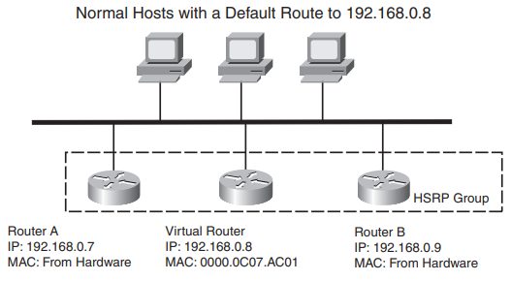
Link Local Scope
By definition, all group addresses in the link local scope are valid only within a link; that is, within the LAN. Packets destined to such a link local address are never routed outside the LAN. This also means that no attacker can ever send a forged HSRP packet to a target on a remote LAN because all routers in the path simply drop this packet.
The Time to Live (TTL) field of all HSRP messages is set to 1, so they are never forwarded outside of the local Ethernet segment.
NOTE Routers sending HSRP with a TTL of 1 does not prevent a remote attacker from sendin HSRP with a TTL higher than 1. But the IP group multicast address has only a link local scope, so an attacker’s HSRP packets addressed to the HSRP group address will never reach the target.

Slide 4
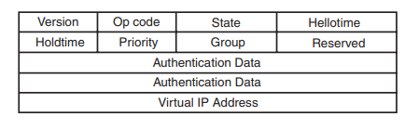
Digging into HSRP
This section provides detailed information on HSRP (as described in RFC 2281 and extensions implemented by Cisco). HSRP is actually simple. Routers participating in HSRP exchange HSRP messages to discover each other, to elect the active router, and to check the active router’s health. A standby router becomes active when
• It receives no more HSRP hello messages from the active router.
• The active router explicitly wants to become standby. (For example, it just lost its WAN connectivity.)
There is the possibility for a standby router to immediately take over the role of the active router. The HSRP message indicates this coup.
HSRP runs on top of User Datagram Protocol (UDP) on port number 1985 for IPv4 and on port 2029 for IPv6. Packets are sent to multicast address 224.0.0.2 or 224.0.0.102 with TTL 1. Routers use their actual IP address as the source address for protocol packets, not the virtual IP address. This is so that the HSRP routers can identify each other. Standby routers use their own MAC addresses as source MAC, while the active router uses the virtual MAC address.

Slide 5
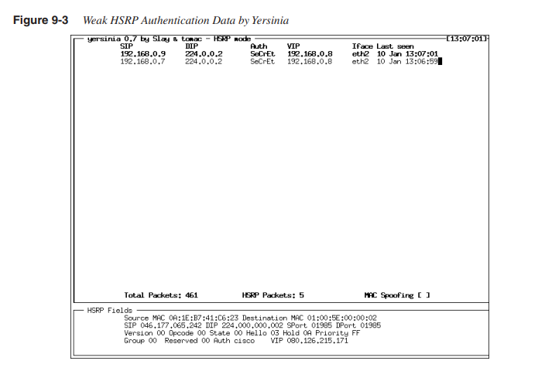
Attacking HSRP
From the preceding section’s descriptions, it appears that HSRP is not completely secure.
The RFC 2281 authors even wrote the following text in the RFC:
This protocol does not provide security. The authentication field found within the message is useful for preventing misconfiguration.
The protocol is easily subverted by an active intruder on the LAN. This can
result in a packet black hole and a denial of service attack.
Also, it is easy for an attacker to display those HSRP authentication data. Figure 9-3 shows Yersinia that can recover the authentication data SeCrEt.

Slide 6
Three types of HSRP vulnerabilities exist:
DoS attack
Man-in-the-middle attack
Information leakage

Slide 7
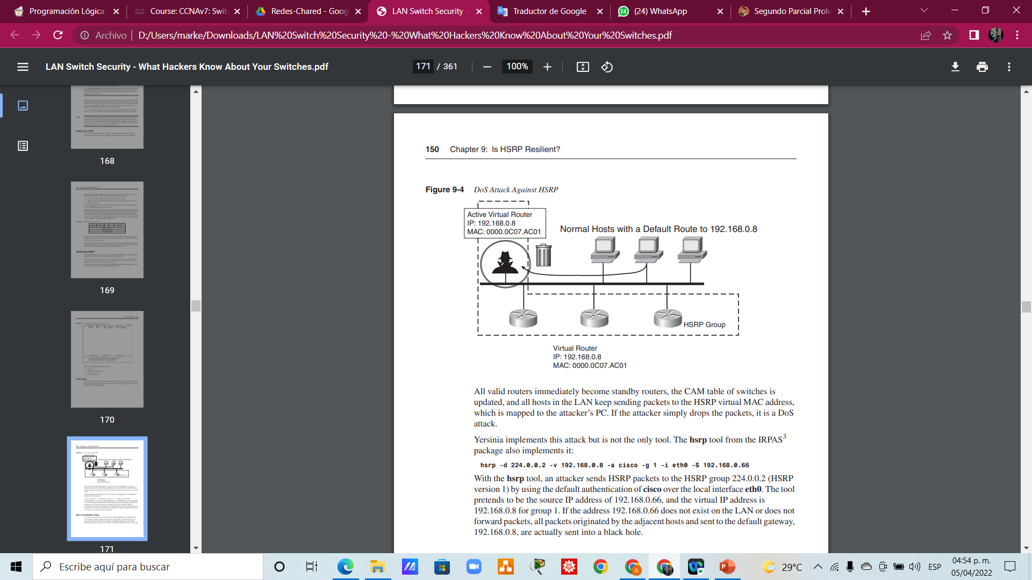
DoS Attack
What if an attacker can send a fake HSRP packet where the priority is set to the maximum value of 255 and the correct value for Authentication Data, Group, and virtual IP address?
Figure 9-4 shows what happens.

Slide 8
Explanation of Figure 9-4
All valid routers immediately become standby routers, the CAM table of switches is
updated, and all hosts in the LAN keep sending packets to the HSRP virtual MAC address,
which is mapped to the attacker’s PC. If the attacker simply drops the packets, it is a DoS
attack.
Yersinia implements this attack but is not the only tool. The hsrp tool from the IRPAS3
package also implements it:
hsrp -d 224.0.0.2 -v 192.168.0.8 -a cisco -g 1 -i eth0 -S 192.168.0.66
With the hsrp tool, an attacker sends HSRP packets to the HSRP group 224.0.0.2 (HSRP
version 1) by using the default authentication of cisco over the local interface eth0. The tool pretends to be the source IP address of 192.168.0.66, and the virtual IP address is
192.168.0.8 for group 1. If the address 192.168.0.66 does not exist on the LAN or does not
forward packets, all packets originated by the adjacent hosts and sent to the default gateway, 192.168.0.8, are actually sent into a black hole.

Slide 9
Man-in-the-Middle Attack
The Man-in-the-Middle Attack is a variant of the DoS attack, which occur when an attacker forwards the traffic between a host and router.
The attacker intercepts all traffic leaving the LAN, and he can sniff the traffic and modify or inject data.

Slide 10
Information Leakage
Information leakage is not a critical vulnerability because neither a breach in confidentiality nor a service disruption exists. HSRP commits a slight information leakage by advertising all the routers’ IP addresses. An attacker can guess when Cisco routers are in play mode. They have more knowledge about the target and can launch specific attacks against Cisco routers.

Slide 11
Mitigating HSRP Attacks
Are HSRP’s vulnerabilities critical? After all, other Layer 2 attacks can lead to the same
results: ARP spoofing, DHCP spoofing, and so on. However, as the other attacks can be
mitigated, HSRP is the only risk exposure whose risks need to be mitigated.
The good news is that the DoS, MITM, and information leakage attacks work only in the
local Ethernet segment. Indeed, the 224.0.0.2 and 224.0.0.102 multicast addresses are for
multicasting only on the local link; packets sent to those addresses are never forwarded on.
Nevertheless, the attacks can be easily launched locally. The ways to mitigate these attacks rely on preventing an attacker from doing the following:
• Forging valid authentication data. If the attacker is unable to present the correct credentials, all other routers reject his packets.
• Sending HSRP packets. The network infrastructure blocks all HSRP packets except those sent by authorized HSRP routers.

Slide 12
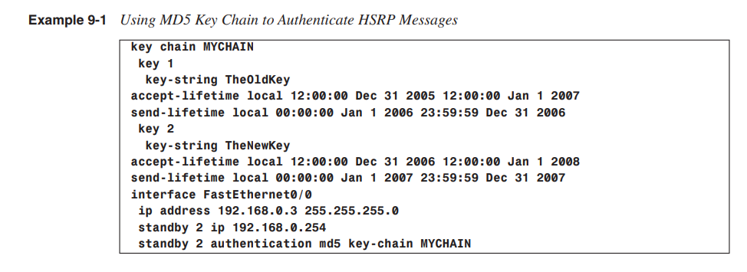
Using Strong Authentication
The easiest way to partly mitigate an HSRP attack is to use strong authentication. Cisco routers and switches running 12.3(2)T and above can use a message digest algorithm 5 (MD5) Hash Message Authentication Code (HMAC) to authenticate all HSRP packets without ever sending the key in the clear.
Example 9-1 shows the syntax when you use a
chain of preshared keys: Each key has a send lifetime (when this key sends HSRP messages) and an accept lifetime (when this key checks the validity of received HSRP messages).

Slide 13
With this configuration in place, an attacker has no way to discover the preshared key that’s
currently in use. Therefore, an attacker cannot send forged HSRP messages that the real
HSRP routers accept and process.
NOTE Rather than using the configuration in Example 9-1, where a key chain is used, use a
simpler method by directly specifying the preshared key. But, if you ever have to roll the
keys, this simplicity complicates your life.

Slide 14
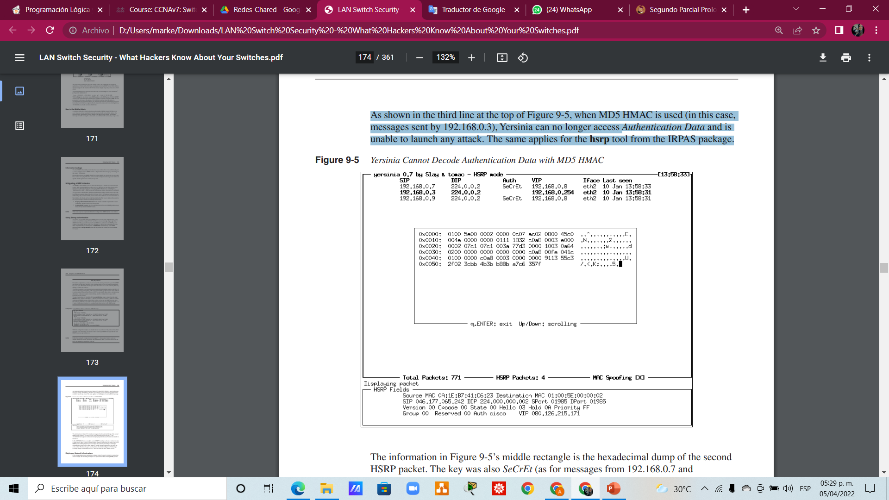
As shown in the third line at the top of Figure 9-5, when MD5 HMAC is used (in this case,
messages sent by 192.168.0.3), Yersinia can no longer access Authentication Data and is
unable to launch any attack. The same applies for the HSRP tool from the IRPAS package.

Slide 15
Relying on Network Infrastructure
If the strong authentication mitigation technique cannot be used or when it is deemed not
secure enough, the remaining technique is to prevent hosts from sending HSRP packets.
This can be implemented with an inbound access control list (ACL) on all routers and
switches.
Even if it looks less advanced compared to the cryptographic technique, it is actually more secure because an attacker cannot bypass it. An operational cost exists for this technique because the ACL is linked to IP addresses. So, if one host changes its IP address, the ACL must be changed. The ACL relies on IP addresses, so an antispoofing mechanism, such as IP source guard, must be used.

Slide 16
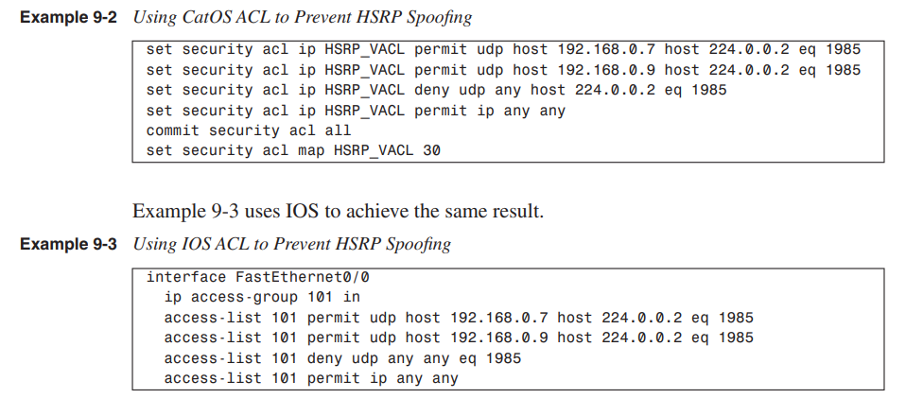
To prevent HSRP attacks, Dynamic ARP Inspection (DAI) must be deployed in combination with any other technique. The ACL depends on the exact network topology, so the following examples are just examples that you must modify based on your exact configuration. Example 9-2 uses CatOS to define such an ACL, permitting HSRP packets from the valid router but not from attached hosts. This VLAN ACL is then applied to VLAN 30.

Slide 17
Summary HSRP has a major vulnerability—the lack of strong authentication and antireplay in the RFC 2281. This opens the door to DoS attacks and to MITM attacks. The latter can be used for attacks against integrity and confidentiality. You can mitigate these attacks in two ways: • Use MD5 HMAC to authenticate all HSRP messages. This is easy to deploy, but it does not protect against replay attacks. • Use an ACL to forbid attached hosts from sending HSRP messages. This must be complemented with a strict antispoofing mechanism. The ACL technique is preferred.

